Slide 1
Finding Maximal 2-dimensional Palindromes
Sara Geizhals, Dina Sokol
27th Annual Symposium on Combinatorial Pattern Matching (CPM 2016)
Leibniz International Proceedings in Informatics (LIPIcs), Volume 54, pp. 19:1-19:12
Presenter: Guan-Jie Chen
Date: Nov. 14, 2023

Slide 2
Abstract
This paper extends the problem of palindrome searching into a higher dimension, addressing two definitions of 2D palindromes. The first definition implies a square, while the second definition (also known as a centrosymmetric factor), can be any rectangular shape. We describe two algorithms for searching a 2D text for maximal palindromes, one for each type of 2D palindrome. The first algorithm is optimal; it runs in linear time, on par with Manacher’s linear time 1D palindrome algorithm.

Slide 3
Abstract (cont.)
The second algorithm searches a text of size n₁ × n₂ (n₁ ≥ n₂) in O(n₂) time for each of its n₁ × n₂ positions. Since each position may have up to O(n₂) maximal palindromes centered at that location, the second result is also optimal in terms of the worst-case output size.

Slide 4
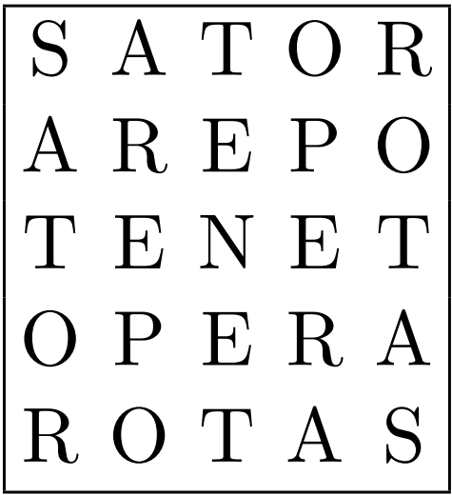
Square 2D palindrome (sq2DP)
m × m
Two diagonal reflections
180◦ rotation

Slide 5
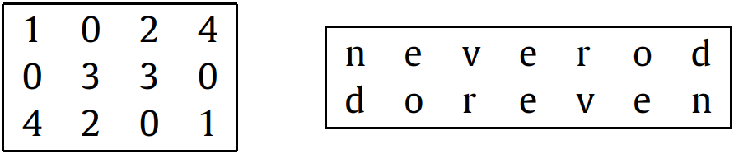
Rectangle 2D palindrome (rect2DP)
180◦ rotation

Slide 6
sq2DP
Preprocessing: constructing a generalized suffix tree
Purpose: finding longest common prefix in O(1)

Slide 7
1D Palindrome
String: abacaba
index | 1 | 2 | 3 | 4 | 5 | 6 | 7
value | 1 | 3 | 1 | 7 | 1 | 3 | 1

Slide 8
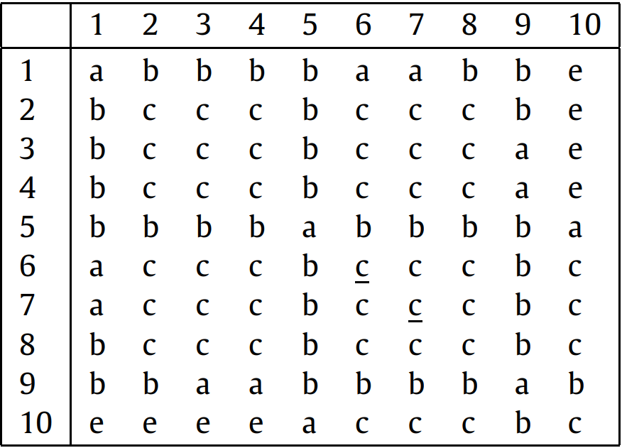
sq2DP (cont.)
index | 1 | 2 | 3 | 4 | 5 | 6 | 7 | 8 | …
value

Slide 9
sq2DP (cont.)
index | 1 | 2 | 3 | 4 | 5 | 6 | 7 | 8 | …
value | 1

Slide 10
sq2DP (cont.)
index | 1 | 2 | 3 | 4 | 5 | 6 | 7 | 8 | …
value | 1 | 1

Slide 11
sq2DP (cont.)
index | 1 | 2 | 3 | 4 | 5 | 6 | 7 | 8 | …
value | 1 | 1 | 3

Slide 12
sq2DP (cont.)
index | 1 | 2 | 3 | 4 | 5 | 6 | 7 | 8 | …
value | 1 | 1 | 3 | 1
pals[4] = pals[2] = 1

Slide 13
sq2DP (cont.)
index | 1 | 2 | 3 | 4 | 5 | 6 | 7 | 8 | …
value | 1 | 1 | 3 | 1

Slide 14
sq2DP (cont.)
index | 1 | 2 | 3 | 4 | 5 | 6 | 7 | 8 | …
value | 1 | 1 | 3 | 1 | 5

Slide 15
sq2DP (cont.)
index | 1 | 2 | 3 | 4 | 5 | 6 | 7 | 8 | …
value | 1 | 1 | 3 | 1 | 5 | 1
pals[6] = pals[4] = 1

Slide 16
sq2DP (cont.)
index | 1 | 2 | 3 | 4 | 5 | 6 | 7 | 8 | …
value | 1 | 1 | 3 | 1 | 5 | 1

Slide 17
sq2DP (cont.)
index | 1 | 2 | 3 | 4 | 5 | 6 | 7 | 8 | …
value | 1 | 1 | 3 | 1 | 5 | 1 | 4 | … | …

Slide 18
sq2DP (cont.)
Time complexity: O(n²)
Preprocessing: O(n²)
Scanning: O(n²)

Slide 19
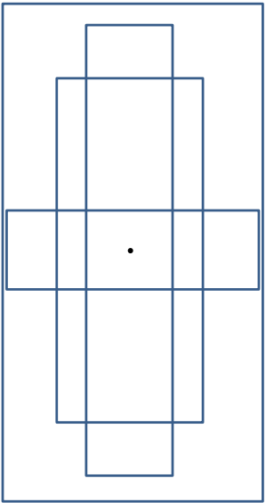
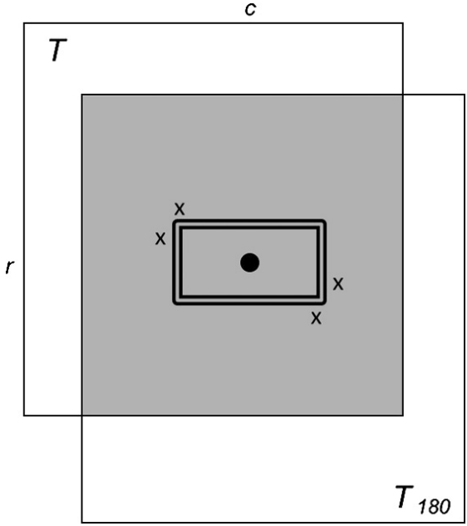
rect2DP

Slide 20
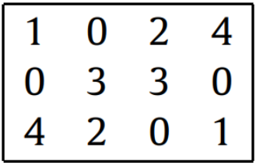
rect2DP (cont.)
Preprocessing: constructing a generalized suffix tree
Purpose: finding longest common prefix in O(1)

Slide 21
rect2DP (cont.)
e e e e e e e e
e e d d b b e e
e d c c a c c b
e e e b b d e e
e e e e e e e e
e e e e e e e e
e e e e e e e e
e e e e e e e e
e e d b b e e e
b c c a c c d e
e e b b d d e e
e e e e e e e e
T
T₁₈₀

Slide 22
rect2DP (cont.)
- e e e e e e e e
e e e e e e e e e
e e x d b b e e e
e x c c a c c x e
e e e b b d x e e
e e e e e e e e e
e e e e e e e e -
index | 1 | 2 | 3 | 4 | 5 | 6 | 7
value | 0 | 1 | 3 | 3 | 3 | 3 | 0

Slide 23
rect2DP (cont.)
- e e e e e e e e
e e e e e e e e e
e e x d b b e e e
e x c c a c c x e
e e e b b d x e e
e e e e e e e e e
e e e e e e e e -
index | 1 | 2 | 3 | 4 | 5 | 6 | 7
value | 0 | 1 | 3 | 3 | 3 | 3 | 0

Slide 24
rect2DP (cont.)
Time complexity: O(n³)
Preprocessing: O(n²)
Scanning: O(n³)

Slide 25
Thanks for your patience

